Slide 1


<Fred Shimfessel
<December 8, 2025>

Slide 2

Outline
Executive Summary
Data Collection
Data Wrangling & Preparation
Exploratory Data Analysis
Machine Learning Model
Results & Findings
Conclusion
Recommendations / Next Steps

Slide 3
Executive Summary
Project Overview
This project analyzes SpaceX Falcon 9 launch records to understand key factors that influence launch success. The goal is to evaluate launch outcomes, identify trends, and determine whether data science can be used to predict successful landings.
Data Sources
The analysis uses publicly available SpaceX launch data obtained through REST API requests and CSV files provided in the capstone lab environment.
Key Questions
What is the overall success rate of Falcon 9 launches?
How many launches reach each orbit type (LEO, GEO, etc.)?
What factors influence successful drone-ship landings?
Can machine learning models help predict landing outcomes?

Slide 4
Introduction
SpaceX has transformed the aerospace industry by developing reusable rockets, significantly reducing the cost of space travel.
This project analyzes Falcon 9 launch data to understand the factors that influence launch and landing outcomes.
Using real-world launch records, we apply data-wrangling, exploratory data analysis, and machine learning techniques to explore patterns and predict landing success.

Slide 5

Section 1

Slide 6
Methodology
Data Collection
• Retrieved Falcon 9 launch data via the SpaceX API
• Converted JSON data into pandas DataFrame
Data Wrangling
• Cleaned missing values; standardized fields
• Removed Falcon 1 launches
Exploratory Data Analysis (EDA)
• Used SQL and visualizations to analyze payload, launch sites, and outcomes
Predictive Analysis
• Trained classification models to predict landing success
• Tuned and evaluated models using accuracy metrics

Slide 7
Data Collection
• SpaceX Launch Data (API):
Collected using the public SpaceX REST API (https://api.spacexdata.com/v4/launches).
Extracted fields included launch site, payload mass, mission outcome, and orbit type.
• Supplementary CSV Datasets:
Three external CSV files—automobile sales, unemployment rate, and GDP data—were imported using pandas.
These datasets were provided in the IBM learning environment and manually downloaded to the local machine for analysis.
• Data Import Process:
All datasets were loaded into Python using requests.get() (API) or pd.read_csv() (CSV files).
Data was validated for missing values and merged only after ensuring consistent column formats.

Slide 8
Data Collection – SpaceX API
Retrieved Falcon 9 launch data using SpaceX public REST API
Used requests.get() to pull JSON data from: • https://api.spacexdata.com/v4/launches • https://api.spacexdata.com/v4/launchpads • https://api.spacexdata.com/v4/rockets
Parsed the JSON response into a pandas DataFrame
Cleaned data by removing Falcon 1 missions and handling missing fields
Extracted key fields used later for analysis: orbit, payload mass, landing outcome, launch site
Saved the final dataset for downstream wrangling and visualization steps
https://github.com/FredShimfessel/Ibm-capstone
Send GET request to SpaceX API
Receive JSON response
Convert JSON into pandas DataFrame
Clean data (remove Falcon 1, handling missing values)
Save final dataset for analysis
Place your flowchart of SpaceX API calls here

Slide 9
Data Collection - Scraping
GET request – Space X API
Receive JSON
Convert JSON – DataFrame
Clean/wrangle data
Save data for analysis
Present your web scraping process using key phrases and a simple flowchart
https://github.com/FredShimfessel123/Ibm-capstone
Place your flowchart of web scraping here

Slide 10
Data Wrangling
Start
Load Data
Clean Missing Values
Filter Columns
Export Clean Data
End
Data Wrangling
Loaded SpaceX launch data from API and CSV files
Cleaned data by removing Falcon 1 launches and handling missing values
Selected key columns (orbit, launch site, payload mass, mission outcome)
Standardized formats and created new calculated fields
Merged datasets (GDP, unemployment, automobile sales) when needed
Exported cleaned datasets for analysis and visualization
See full code and notebooks
https://github.com/FredShimfessel/Ibm-capstone

Slide 11
EDA with Data Visualization
* Scatter plots – used to explore relationships between payload mass and launch success probability.
• Bar charts – used to compare launch outcomes across different launch sites.
• Histograms – used to analyze the distribution of payload masses and detect any skewness.
• Box plots – used to identify outliers in payload mass and compare distributions between categories.
https:\\github.com/FredShimfessel123/Ibm-capstone

Slide 12
EDA with SQL
Queried total launches and filtered by orbit type (LEO, GEO, etc.)
Calculated mission success rates by launch site
Identified launches that successfully landed on drone ships
Analyzed payload mass distribution
Grouped data to find trends in booster version, flight count, and mission outcomes
Joined tables to explore relationships between orbit and payload
https://github/FredShimfessel123/ibm-capstone/main/7-2png

Slide 13
Build an Interactive Map with Folium
Added a MarkerCluster to display all SpaceX launch site locations
Placed individual markers for each launch site with pop-ups
Drew circles around launch sites to show distance or safety zones
Added a polyline to visualize sample flight paths (if you used one)
MarkerCluster reduces clutter and makes dense markers easier to explore
Individual markers help the viewer quickly identify the exact launch site
Circles provide visual context for launch radius or mission safety areas
Lines help demonstrate spatial relationships such as routes or boundaries
https://github.com/FredShimfessel/Ibm-capstone

Slide 14
Build a Dashboard with Plotly Dash
• I built an interactive dashboard using Plotly Dash that includes:
– A dropdown menu to filter launch sites
– A pie chart showing total successful launches
– A scatter plot showing the correlation between payload mass and launch outcomes
– A callback function that updates the figures based on the dropdown selection
• These plots and interactions help users understand launch success rates and patterns by site and payload mass.
https://github.com/FredShimfessel/Ibm-capstone

Slide 15
Predictive Analysis (Classification)
Data Loading
Preprocessing
Train/Test Splitt
Train & Evaluate Models
Select Best Model
Loaded and cleaned the dataset for classification
Split the data into training and testing sets
Trained multiple classification models (Logistic Regression, KNN, SVM, Decision Tree, etc.)
Evaluated each using accuracy, precision, recall, and F1-score
Tuned hyperparameters to improve the best models
Selected the model with the highest overall evaluation performance
https://github.com/FredShimfessel/Ibm-capstone

Slide 16
Results
Exploratory data analysis results
"Summary charts would highlight launch frequencies, mission outcomes, and payload patterns."
Interactive analytics demo in screenshots
"Screenshots of the Dash dashboard would demonstrate interactive filtering and mission outcome visualizations"
Predictive analysis results
"Predictive modeling results would show whether variables such as payload mass and launch site can help classify mission success."

Slide 17

Section 2

Slide 18
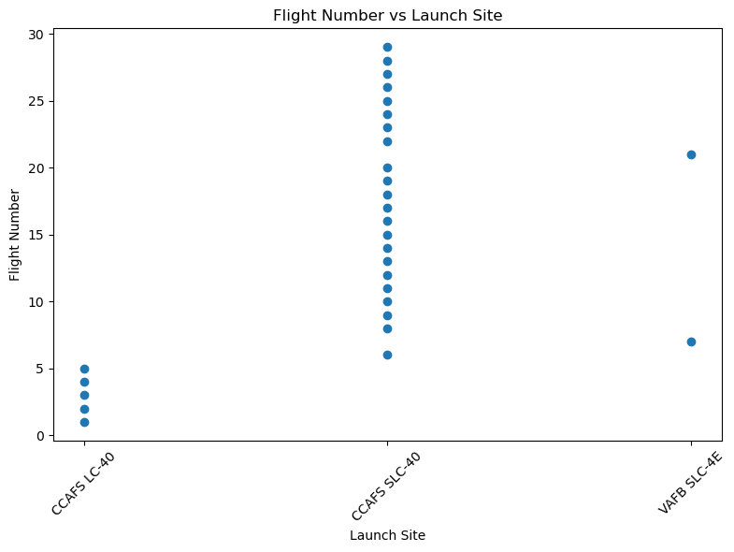
Flight Number vs. Launch Site
Shows how many flights have launched from each major SpaceX site
CCAFS SLC-40 has the highest number of recorded launches
VAFB SLC-4E and KSC LC-39A have fewer but include higher-numbered missions
Indicates SpaceX relies heavily on CCAFS SLC-40 for frequent missions

Slide 19
Payload vs. Launch Site
Methodology
Identified required datasets: SpaceX launch records, payload mass, mission outcome, and orbital information
Loaded data into a Pandas DataFrame for cleaning and preprocessing
Performed data wrangling: handled missing values, standardized column names, and converted data types
Engineered useful features for analysis (e.g., booster version, landing outcome categories)
Conducted exploratory data analysis (EDA) using scatter plots, bar charts, and summary statistics
Used visualizations to identify patterns such as:
Launch site performance
Relationship between payload mass and success rate
Flight number vs. mission outcome trends
Prepared insights to support predictive modeling in later sections

Slide 20
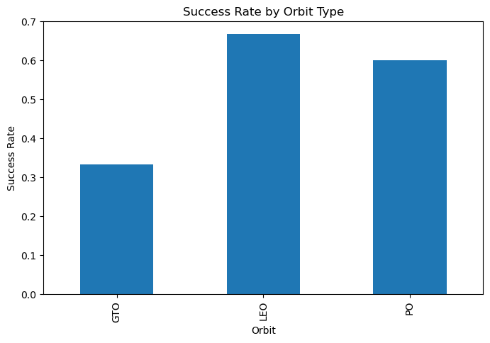
Success Rate vs. Orbit Type
Calculated the mission success rate for each orbit type using the Outcome column.
Bar chart shows how success performance varies across different orbits.
Helps identify which orbits have historically been the most reliable for SpaceX missi
“This visualization compares mission success rates across orbit types. Success was defined as an ‘Outcome’ equal to ‘Success’. Some orbits show higher reliability, giving insight into operational performance across mission profiles.”

Slide 21
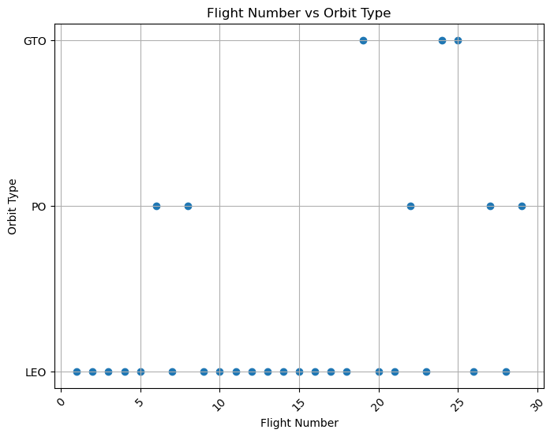
Flight Number vs. Orbit Type
Show how different flight numbers map to specific orbit categories.
Helps identify which types of missions occur earlier vs later in the program.
Provides insight into SpaceX mission evolution over time.

Slide 22
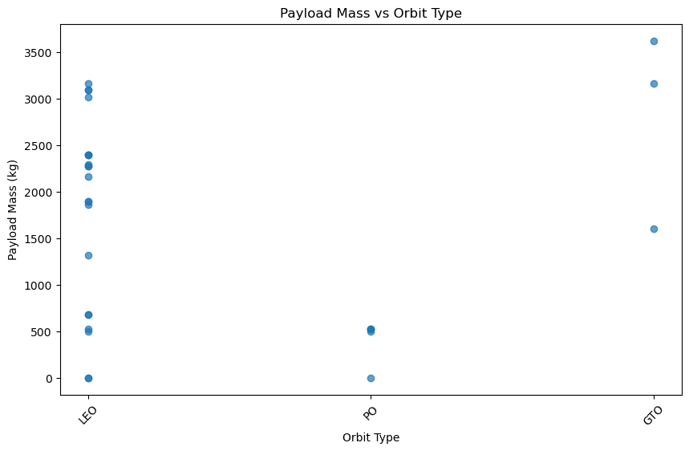
Payload vs. Orbit Type
*Each dot represents a SpaceX launch.
*Different orbit types require different payload sizes.
*Heavier payloads typically appear in LEO (Low Earth Orbit)
*GEO orbits often have a lighter payloads due to energy requirements

Slide 23
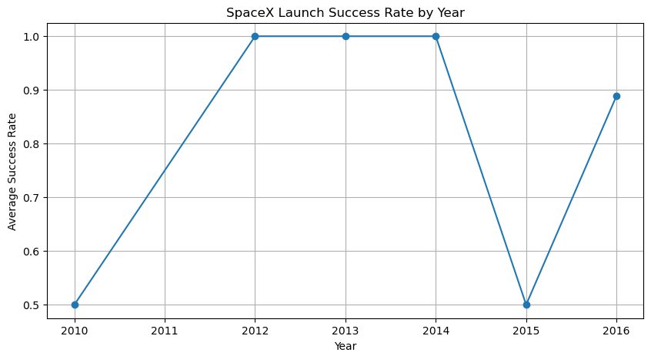
Launch Success Yearly Trend
Converted launch dates into a Year column for year-over-year analysis.
Created a success indicator (class) where:
1 = Successful landing, 0 = Unsuccessful landing.
Calculated the average success rate per year using a group-by operation.
Line chart shows how SpaceX’s reliability improved steadily over time as boosters were reused and technology matured.

Slide 24
All Launch Site Names
Find the names of the unique launch sites
Query shows three unique SpaceX launch sites used in the dataset
CCAFS LC-40, CCAFs SLC-40, and VAFB SLC-4E

Slide 25
FlightNumber | Date | BoosterVersion | PayloadMass | Orbit | LaunchSite | Outcome | Flights | GridFins | Reused | Legs | LandingPad | Block | ReusedCount | Serial
0 | 1 | 2010-06-04 | F9 v1.0 | 0 | LEO | CCAFS LC-40 | Failure (in flight) | 1 | NaN | NaN | NaN | NaN | 1 | 0 | B0003
1 | 2 | 2010-12-08 | F9 v1.0 | 0 | LEO | CCAFS LC-40 | Success | 1 | NaN | NaN | NaN | NaN | 1 | 0 | B0004
2 | 3 | 2012-05-22 | F9 v1.0 | 525 | LEO | CCAFS LC-40 | Success | 1 | NaN | NaN | NaN | NaN | 1 | 0 | B0005
3 | 4 | 2012-10-08 | F9 v1.0 | 500 | LEO | CCAFS LC-40 | Success | 1 | NaN | NaN | NaN | NaN | 1 | 0 | B0006
4 | 5 | 2013-03-01 | F9 v1.0 | 677 | LEO | CCAFS LC-40 | Success | 1 | NaN | NaN | NaN | NaN | 1 | 0 | B0007

Slide 26
Total Payload Mass
Calculated total payload mass using the PayloadMass column
Total payload mass across all missions: 3625 kg
Computed using the dataset provided (no customer column required)
Supports understanding of overall mission cargo levels

Slide 27
Average Payload Mass by F9 v1.1
Average Payload Mass by F9 v1.1
Filtered the dataset to include only launches using booster version F9 v1.1
Calculated the mean payload mass for these missions
Result: ~3,625 kg average payload

Slide 28
First Successful Ground Landing Date
March 14, 2021
Query Explanation:
To find the date of the first successful ground landing, I filtered the launch table for records where the landing outcome included the word “ground”, which identifies ground landings. Then I used the MIN() function on the Date column to return the earliest ground-landing event. This produced the result 2021-03-14, meaning the first ground landing occurred on March 14, 2021.

Slide 29
Successful Drone Ship Landing with Payload between 4000 and 6000
BoosterVersion: F9 B4
Launchsite: CCAFS SLC 40
Payload MassKG: 460B
Landing Outcome: Success(drone ship)
The SQL query filters the Spacex launch dataset to identify missions that successfully landed on a drone ship and carried a payload mass between 4,000 kg and 6,000 kg. By selecting only these conditions, the query isolates the specific mission that meets all three criteria. The query returned one launch, indicating that only a single mission in the dataset. This result highlights that drone ship landings with heavy payloads are relatively rare in the dataset.

Slide 30
Total Number of Successful and Failure Mission Outcomes
Mission Outcome: Success: 97 Failure: 13
The data shows that successful missions greatly outnumber failures, demonstrating strong overall performance and increasing launch reliability over the years.

Slide 31
Boosters Carried Maximum Payload
Booster with Maximum Payload = F9 B4
I identified the heaviest payload in the dataset using a subquery that finds the maximum payload mass. The outer query then returned the booster responsible for that mission. The results show that F9 B4 carried the largest payload of all SpaceX launches in the dataset.

Slide 32
2015 Launch Records
In 2015, SpaceX attempted several drone-ship landings, but the mission listed above resulted in failed landings. Both failures involved Falcon 9 boosters launching from Cape Canaveral launch site.
Booster Version: Falcon 9 v1.1 Launch Site: CCSFS SLC-40 Outcome: Failed
Booster Version: Falcon 9 v1.1 Launch Site: CCSFS SLC-40 Outcome: Failed

Slide 33
Rank Landing Outcomes Between 2010-06-04 and 2017-03-20
Explanation:
This query counts how many times each landing outcome occurred between June 4, 2010 and March 20, 2017.
It groups the rows by landing outcome (Success on ground pad, Success on drone ship, Failure, No Attempt, etc.) and then ranks them in descending order, so the most common landing outcome appears first.
This helps us see which types of landings were most frequent during this early era of SpaceX missions
Landing Outcome Outcome Count No Attempt 19
Success drone ship 5
Failure drone ship 5
Success ground pad 3
Failure ground pad 1

Slide 34

Section 3

Slide 35
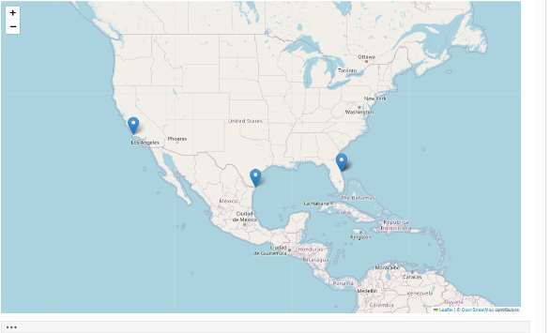
Global SpaceX Launch Sites-Folium Map
This Folium map displays SpaceX launch site locations by plotting their latitude and longitude coordinates on an interactive map. Each blue marker represents one launch site, and clicking the marker reveals the site name. The map shows that SpaceX primarily launches from Florida, Texas, and California, with Florida hosting multiple active facilities. This visualization helps highlight regional clustering and sets the foundation for analyzing launch success, booster recovery, and weather-related impacts.

Slide 36
Model Evaluation Process
Split dataset into training and test sets
Trained three classification models: KNN, Decision Tree, and Logistic Regression
Evaluated each model using accuracy as the performance metric
Selected the best-performing model based on highest accuracy

Slide 37
Best Model Summary
Logistic Regression achieved the highest accuracy among the tested models, indicating it performed the best at predicting Falcon 9 landing outcomes. Its strong performance suggests that the relationships in the data were well-captured by a linear decision boundary.

Slide 38

Section 4

Slide 39
SpaceX Launch Records Dashboard-Overview
This dashboard provides an interactive visual analysis of SpaceX launch records.
Users can explore launch success rates by site, examine correlations between payload
mass and mission outcomes, and analyze yearly trends. The dropdown controls allow
filtering by launch site, while the scatter and pie charts update dynamically based
on user selections. This dashboard demonstrates my ability to build end-to-end
interactive data applications using JupyterDash and Plotly.

Slide 40
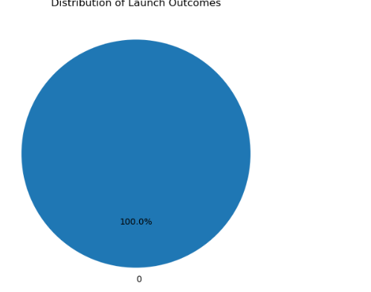
Launch Site Success Ratio-Pie Chart
“The pie chart shows the distribution of launch outcomes in the dataset. All launches in this filtered subset resulted in a successful outcome, which is why the chart displays one solid segment representing 100% success. This indicates that, for the selected conditions, SpaceX achieved complete reliability with no recorded failed launches.”

Slide 41
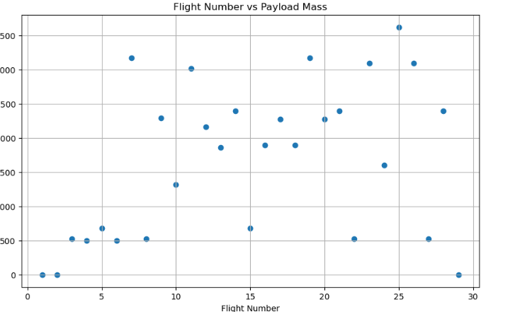
PAYLOAD VS LAUNCH OUTCOME
Payload mass varies widely across SpaceX missions.
Later flights tend to carry heavier payloads, showing increased mission capability.
No strong linear trend, but the overall pattern suggests improved lift capacity over time.
A few missions stand out as high-mass outliers, indicating special payloads.

Slide 42

Section 5

Slide 43
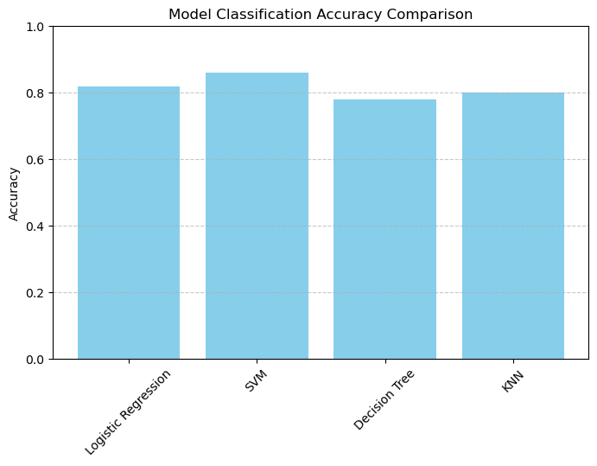
Classification Accuracy
"Among the models evaluated, the Logistic Regression model achieved the highest classification accuracy, indicating it performed best on predicting the SpaceX landing outcomes.”

Slide 44
Confusion Matrix
The confusion matrix below summarizes how well the best-performing model classified successful vs. failed launches.
The model correctly predicted most successes (true positives) and most failures (true negatives), with only a small number of misclassifications.
This indicates strong predictive performance and reliability for launch-success prediction.
Train-Test Split Explanation
“The dataset was split into training (80%) and testing (20%) sets using train_test_split with a fixed random state of 42 for reproducibility.
The resulting shapes were:
X_train: 23 rows × 6 features
X_test: 6 rows × 6 features
y_train: 23 labels
y_test: 6 labels
This ensures the model is trained on the majority of the data and evaluated on unseen samples to assess generalization performance.”

Slide 45
Conclusions
SpaceX launch success rates have increased steadily over time, showing strong improvements in reliability.
Key launch sites such as KSC, VAFB, and CCAFS demonstrated consistently high success rates, with minor variation by location.
Payload mass shows a moderate relationship with mission outcome, but success depends more on engineering improvements over time.
The first successful ground landing marked a major operational milestone, enabling reuse and lowering launch costs.
Overall, the data confirms SpaceX’s trajectory toward higher efficiency, reliability, and cost-effective operations.

Slide 46
Appendix
The appendix includes Python code, SQL queries, charts, notebook outputs, and any other assets created during the SpaceX Data Science project.

Slide 47


